Slide 1
Sickle Cell Anemia Detection Using Convolutional Neural Network Guided By Dr. M. P. Wankhade

Slide 2
Members
Suryansh Saxena
Sujot Sasane
Achal Tajne

Slide 3
Introduction
Sickle Cell Anemia (SCA) is a hereditary blood disorder caused by a genetic mutation that affects the structure of hemoglobin, the protein responsible for carrying oxygen in red blood cells.
This genetic alteration leads to the distinctive sickle shape of red blood cells (RBCs) and results in various complications, including pain, anemia, organ damage, and a decreased lifespan.
Traditionally, SCA diagnosis involves manual examination of blood smears under a microscope to identify the characteristic sickled RBCs. However, this process can be time-consuming, labor-intensive, and subject to inter-observer variability.

Slide 4
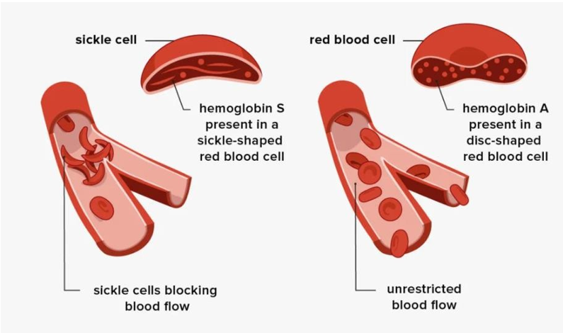
Normal RBCs V/S Sickle Cells

Slide 5
Objectives
To identify individuals affected by the genetic disorder early in their lives or as soon as symptoms manifest.
The foremost objective is to identify individuals with sickle cell anemia as early as possible, ideally through newborn screening programs.
To minimize the negative impact of the disorder by identifying it early, providing appropriate care and support, and promoting public understanding and awareness.

Slide 6
Literature Survey
Name of the Paper | Author | Year | Description
Sickle cell anemia detection using convolutional neural network | Richa Tengshe , Aishwarya U N, Akarsh Raj, Akshaya K | July2021 | This is the base paper for our project, but it lacks accuracy.
Anemia Detection using Machine Learning | Uppu Jhansi Manga Devi,Myla Devaki, SandeepBhusal. | April 2023 | Ideas of using ML resources is derived from this paper.
Automated Semantic Segmentation of Red Blood Cells for Sickle Cell Disease. | MoZhang, XiangLi, Mengjia Xu, Quanzheng Li. | Feb2020 | From this work, we adopt a deep learning based segmentation framework to solve the RBC classification task.

Slide 7
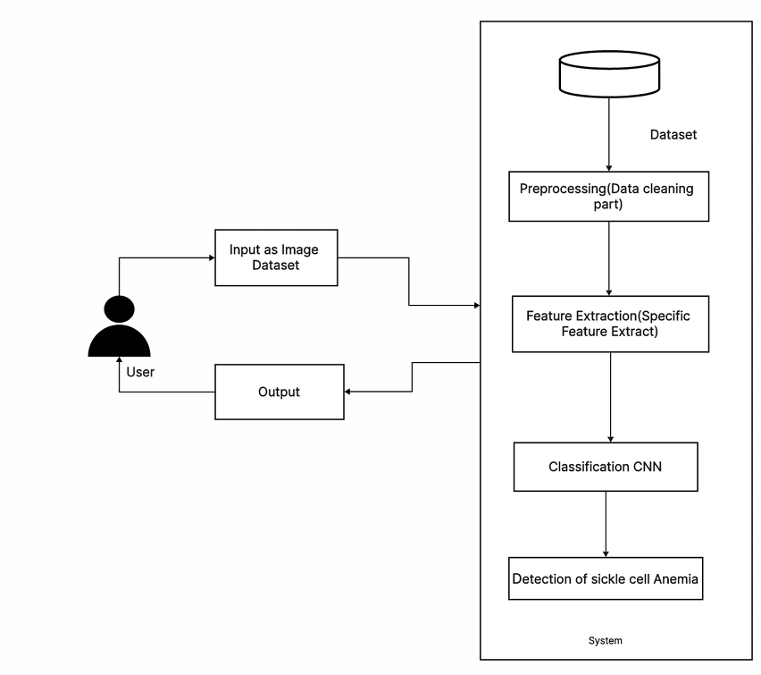
System Architecture

Slide 8
Feasibility & Scope
Feasibility:
Ensure the availability of a comprehensive dataset containing genetic markers, clinical data, and hemoglobin electrophoresis results.
Evaluate the quality and reliability of the available data. Clean and accurate data are crucial for training a robust model.
Scope:
Conduct feature selection techniques to identify the most relevant features for sickle cell anemia detection.
Develop and train machine learning models using appropriate algorithms.

Slide 9
Technical Risk
If the dataset is limited in size or lacks diversity, the machine learning models may not generalize well to different populations.
Identifying the most relevant features for accurate detection can be challenging. Incorrect feature selection might lead to a suboptimal model.
Patient data privacy and security breaches are significant concerns, especially in healthcare applications. Adhering to privacy regulations is crucial.
Complex machine learning models might lack interpretability, making it challenging for healthcare professionals to trust and understand the predictions.

Slide 10
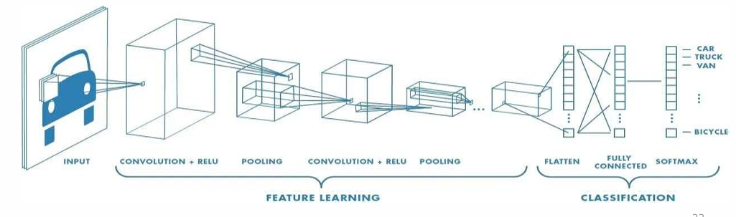
Proposed Algorithm
CNN:
A convolutional neural network (CNN) is a subset of machine learning. It is one of the various types of artificial neural network which are used for different applications and data types.
A CNN is a kind of network architecture for deep learning algorithms and is specifically used for image recognition and tasks that involve the processing of pixel data.

Slide 11
Pre-processing steps
1. Normalization:
These involves adjusting the intensity values of the image to the common scale , to reduce variation between images.
Images are ranging from -1 to 1.
2. Kernel Sizing:
These involves determining the size of the filter (kernel) that will be used in convolution operations.
Used 32 filters of size 1X1.
3. Pooling:
Reduces the spatial dimensions of the feature maps, helping to control overfitting.
We used Max-Pooling .

Slide 12
Watershed Algorithm
The watershed algorithm is a computer vision technique used for image region segmentation. The segmentation process will take the similarity with adjacent pixels of the image as an important reference to connect pixels with similar spatial positions and gray values.
It is an algorithm that correctly determines the outline of an object by identifying the local minima, or the lowest points, in the image as a topographic surface where high intensity denotes peaks and hills while low intensity denotes valleys.
The watershed algorithm uses topographic information to divide an image into multiple segments or regions. The algorithm views an image as a topographic surface, each pixel representing a different height.

Slide 13
Segmentation Algorithm
Segmentation is a technique in computer vision to partition an image into meaningful regions or segments, typically based on similar characteristics like color, texture, or edges.
Segmentation is vital in various fields such as medical imaging for identifying organs or tissues, in autonomous vehicles for object detection, in satellite imaging for land cover classification, and more.
Common methods include thresholding, edge-based segmentation, region-based segmentation, and semantic segmentation, each catering to specific requirements and image properties.
This algorithm is used here to determine the edges of the cells present in the provided image sample of blood specimen, in order to distinguish between normal and sickled cell.

Slide 14
Advantages & limitations
Advantages:
Sickle cell anemia detection allows for early diagnosis, enabling timely medical intervention and appropriate management strategies.
Early detection and management of sickle cell anemia led to better outcomes for patients.
Limitations:
Advanced genetic testing methods can be expensive, limiting accessibility, especially in low-income regions
There might be social stigma associated with sickle cell anemia, leading to discrimination against individuals with the disease or carriers

Slide 15
Conclusion & Future Work
Developing an effective sickle cell anemia detection system is crucial for early diagnosis, appropriate management, and improved outcomes for affected individuals. Through the integration of advanced machine learning techniques and genetic testing methods, significant progress has been made in the field of sickle cell anemia detection. Early diagnosis not only enhances the quality of life for patients but also aids healthcare professionals in providing timely interventions and personalized treatments.
By addressing these areas of future work, the scientific community, healthcare providers, and policymakers can collectively contribute to advancing the field of sickle cell anemia detection, ultimately improving the lives of individuals affected by this genetic disorder and paving the way for a healthier future.

Slide 16
Thank You!

